Slide 1

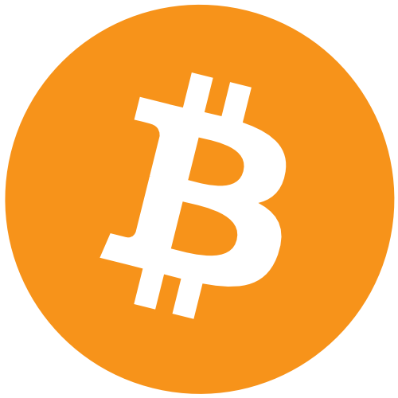
making sense of a personal take
Taha Ali

Slide 2
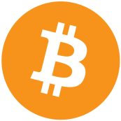
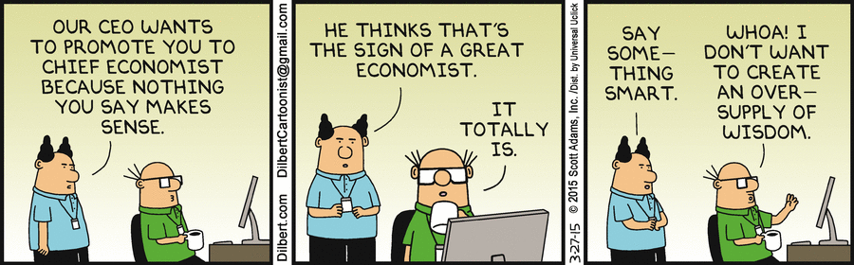
economics

Slide 3
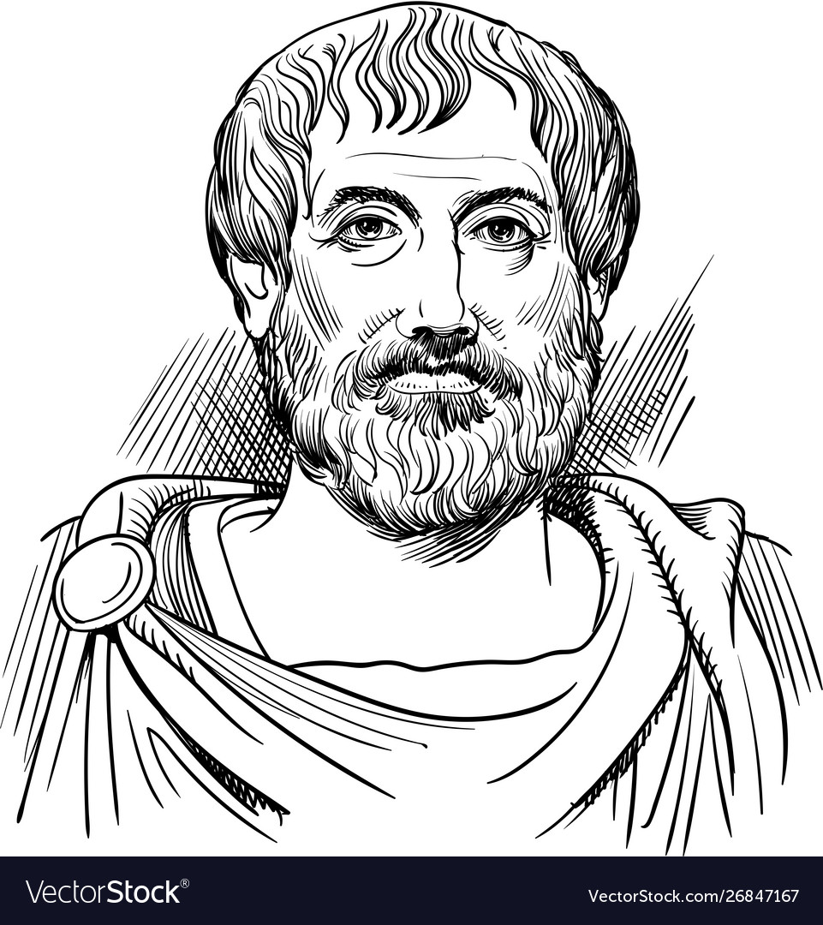
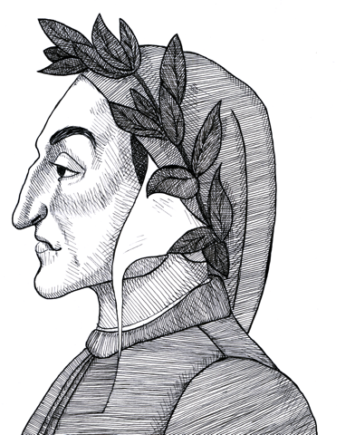
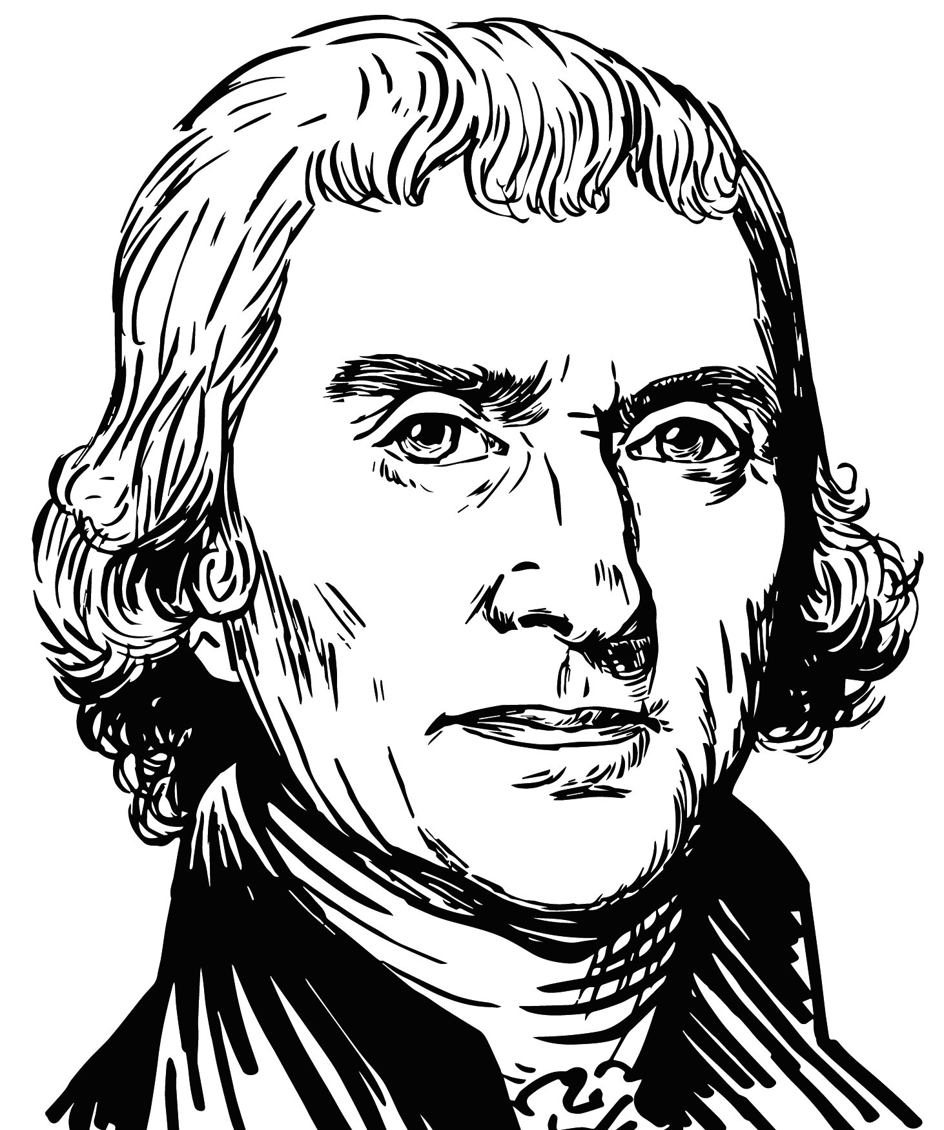
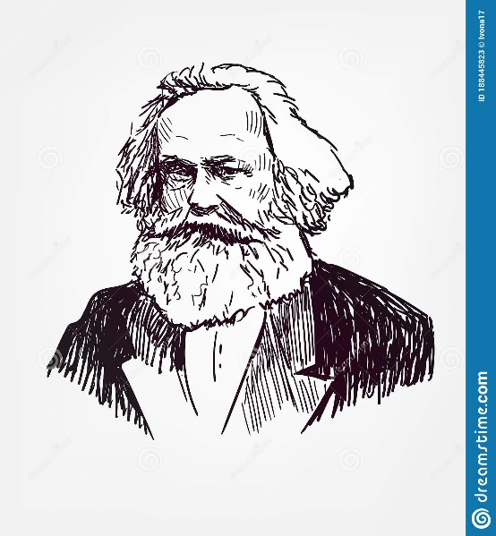
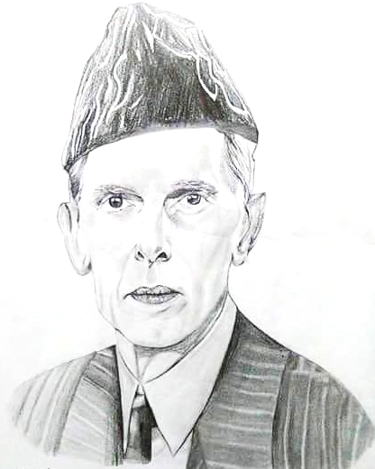
The Anti-bankers
0
Aristotle: the unnatural “breeding of money”
Dante: murderers vs. bankers
Jefferson: worse than “standing armies”
Marx: exceeding “limits”, “one of the most effective
vehicles of crisis and swindle”
Jinnah: “insoluble problems”, “world wars”
Notes:
At the launching ceremony of the State Bank of Pakistan in 1948, Quaid-e-Azam called for an overhaul of the system itself. “The economic system of the West has created almost insoluble problems for humanity,” the Quaid said. “And, to many of us, it appears that only a miracle can save it from the disaster that is now facing the world. It has failed to do justice between man and man and to eradicate friction from the international field. On the contrary, it was largely responsible for the two world wars in the last half-century.”

Slide 4
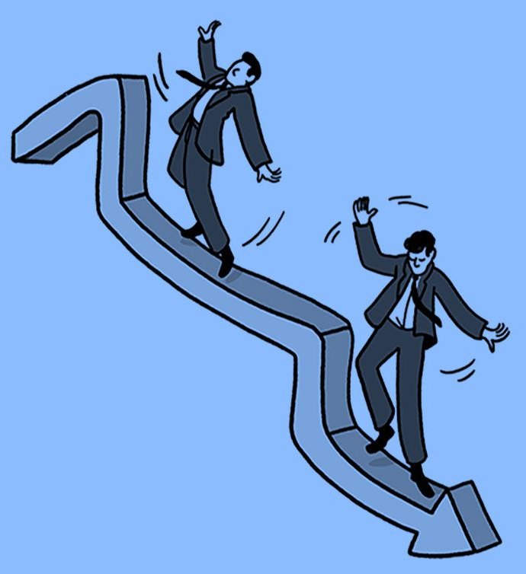
The Great Recession
1
credit default swaps
sub-prime mortgages (NINJA loans)
worst global recession since the 1930s (IMF)
“second Great Depression” – Paul Krugman
bailouts (QE, TARP, bonds)
Notes:
NINJA loans: https://en.wikipedia.org/wiki/No_income,_no_asset
(It works on two levels – as an acronym; and allusion to the fact that NINJA loans are often defaulted on, with the borrower disappearing like a ninja.)

Slide 5
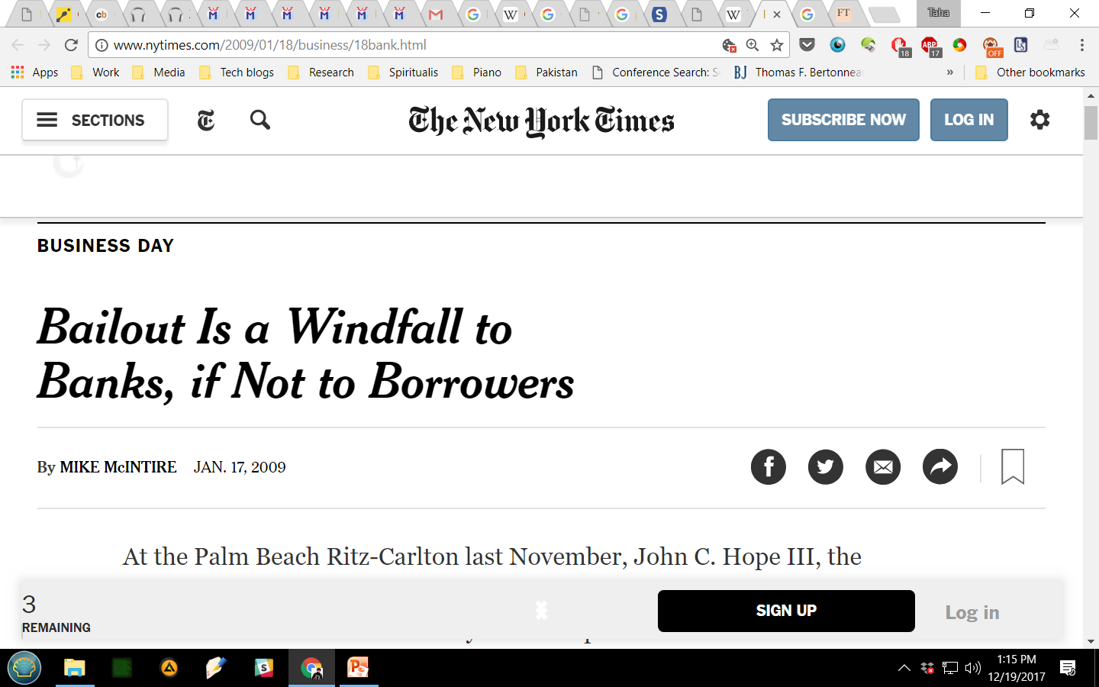
the party begins
2
stimulating growth?
"few [banks] cited lending as a priority. Further, an overwhelming majority saw the program as a no-strings-attached windfall that could be used to pay down debt, acquire other businesses or invest for the future."

Slide 6
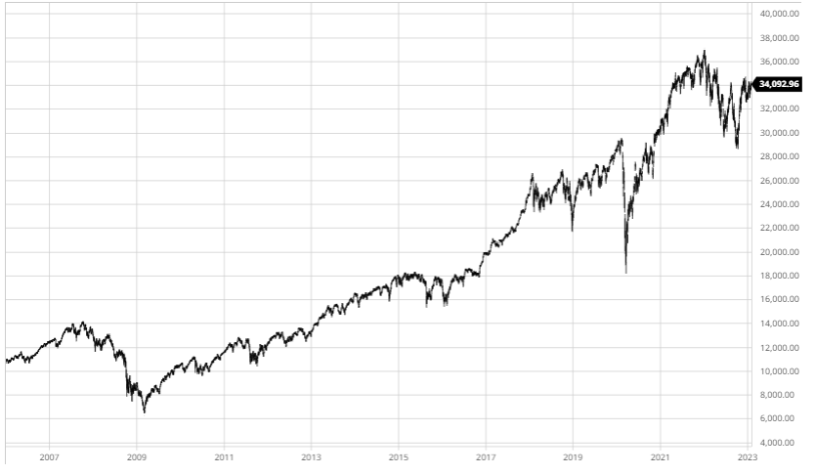
unhinging
3
Dow Jones Industrial Average market index
Notes:
Source: https://www.barchart.com/stocks/quotes/$DOWI/interactive-chart

Slide 7
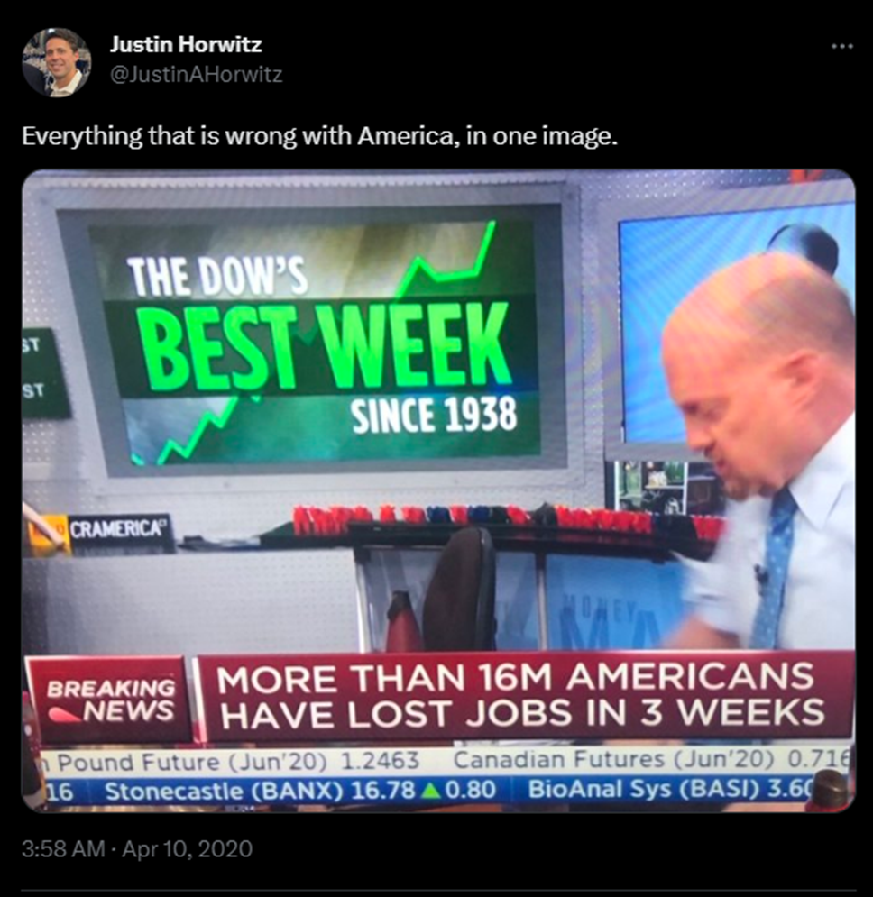
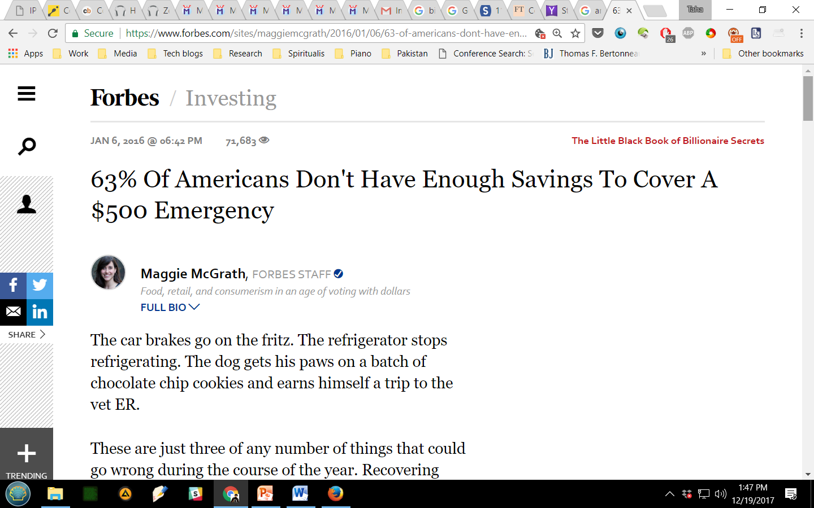
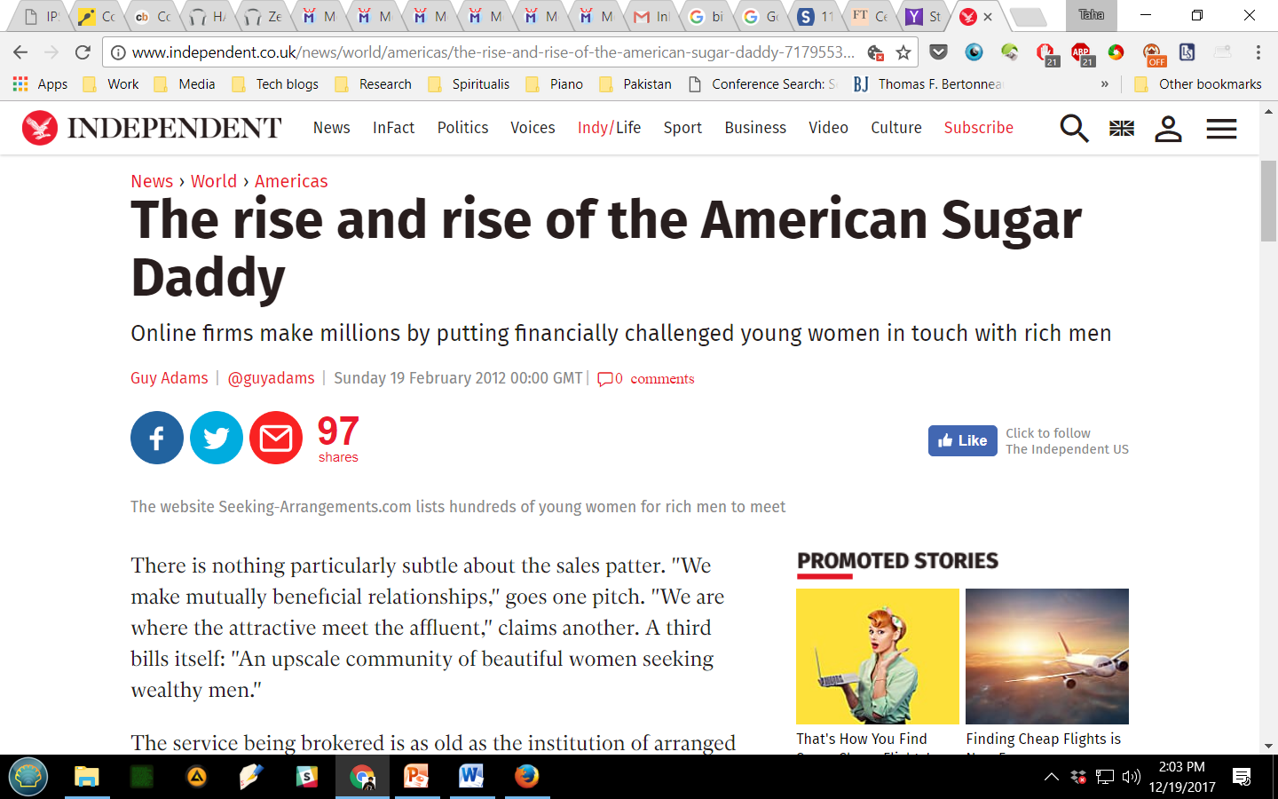
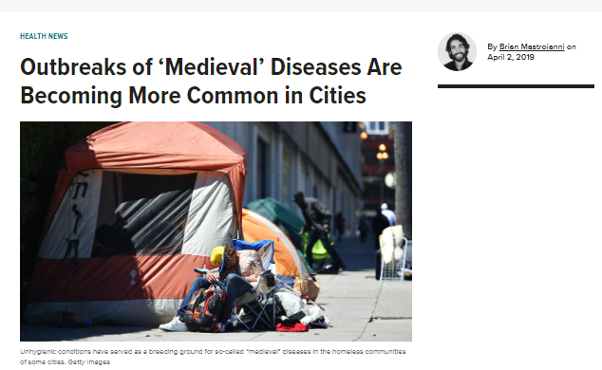
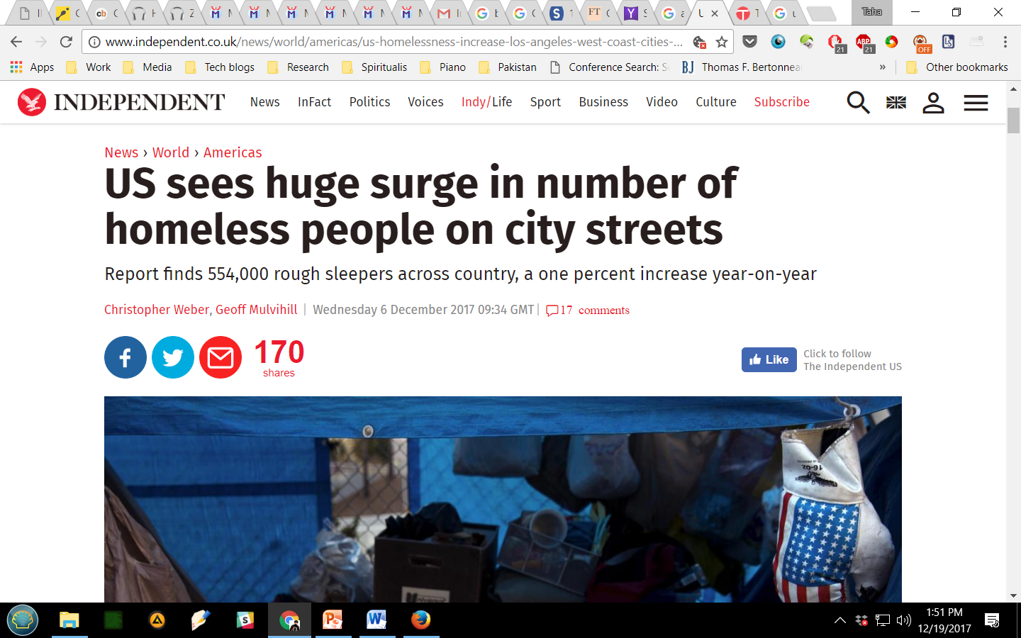
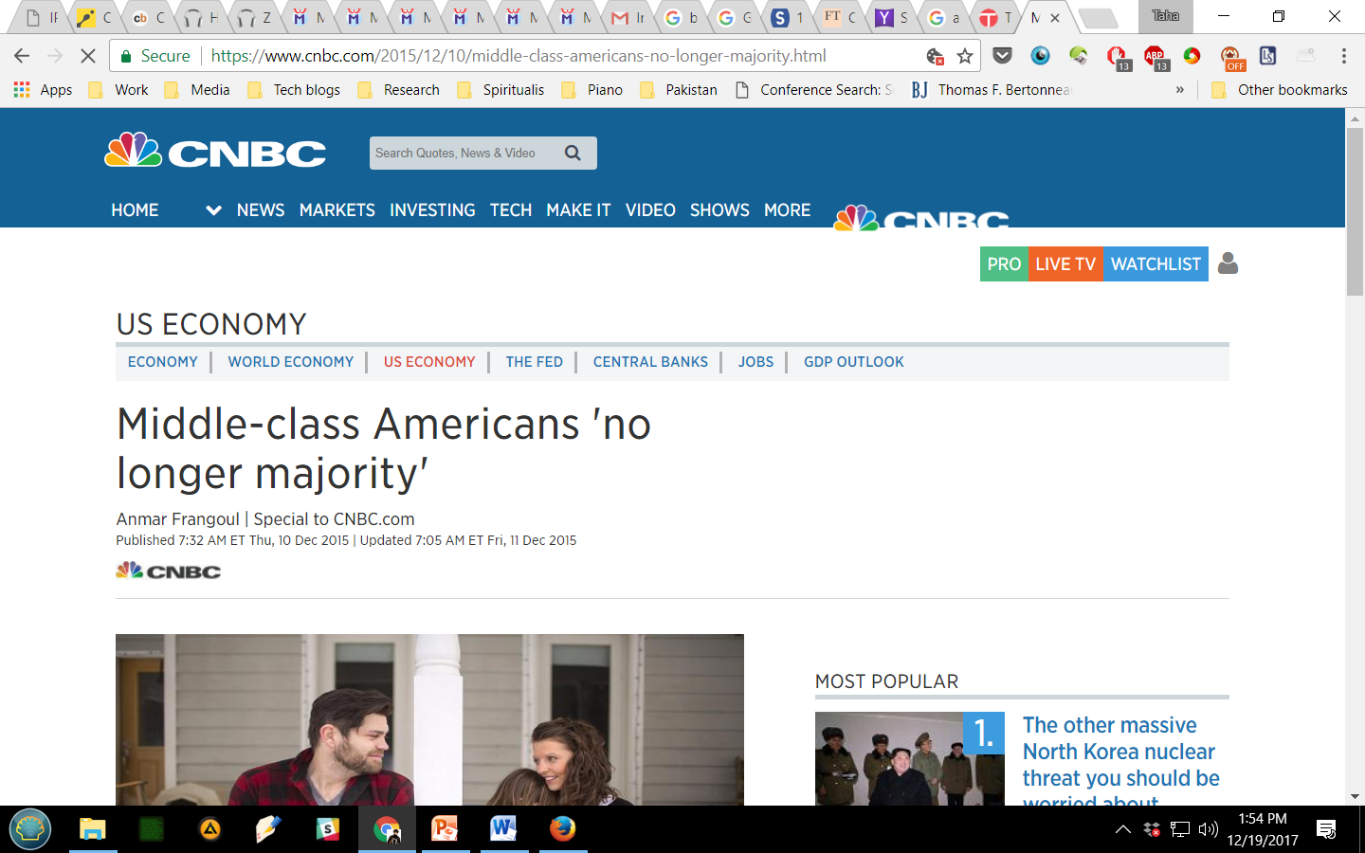
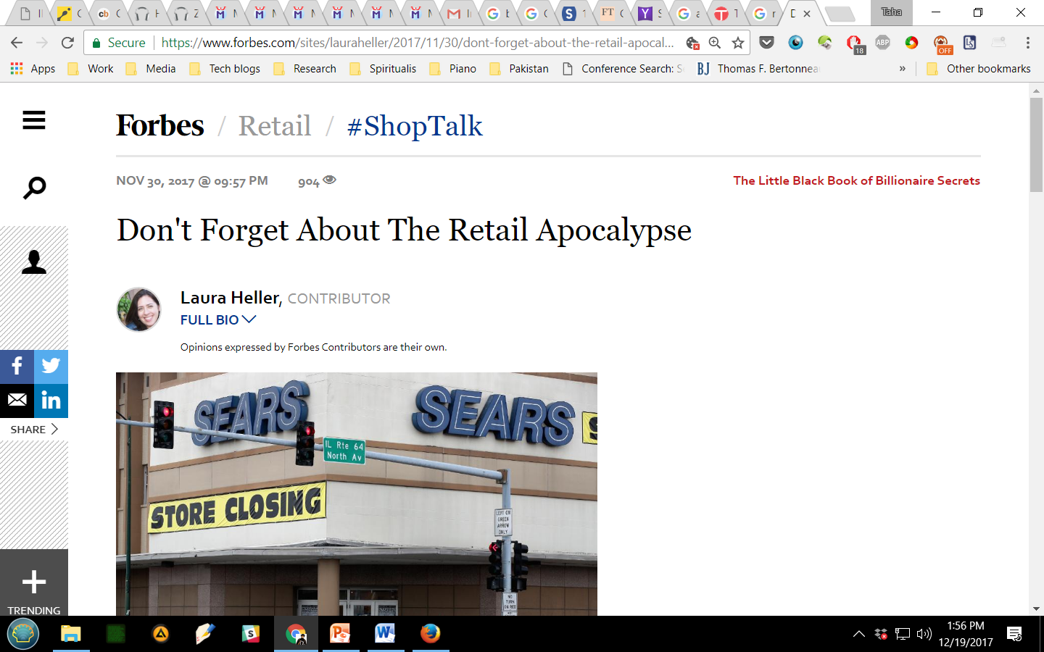
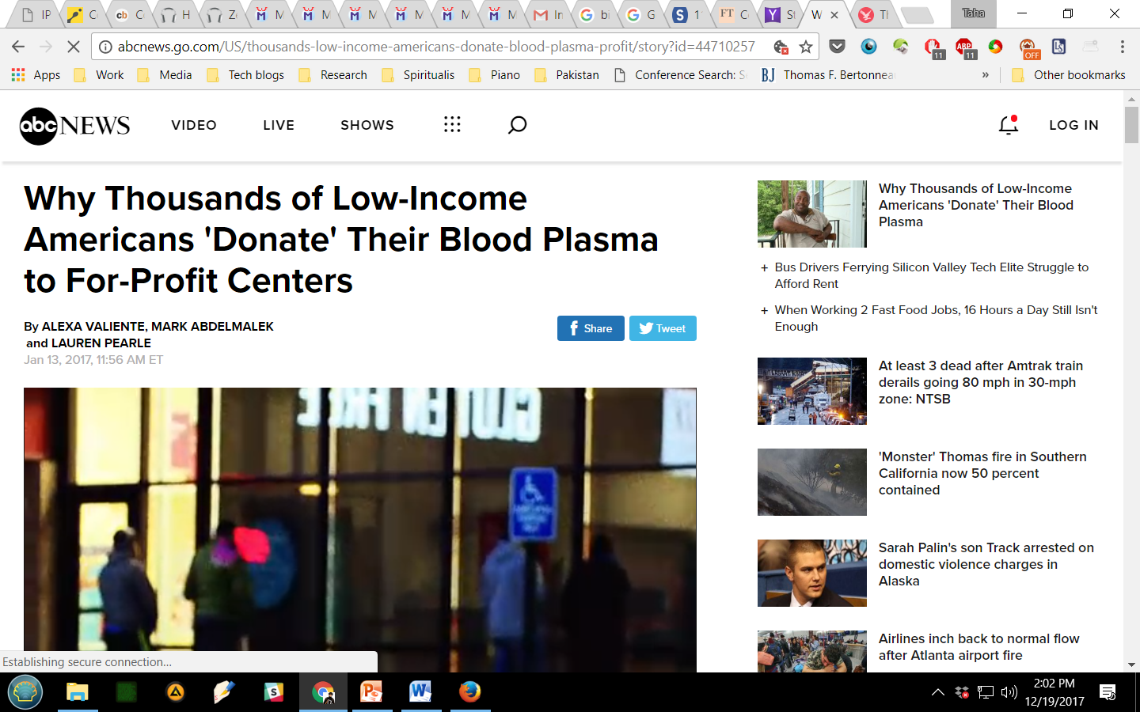
unhinging
4

Slide 8
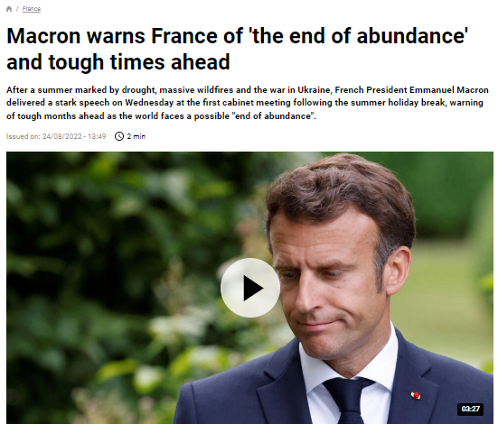
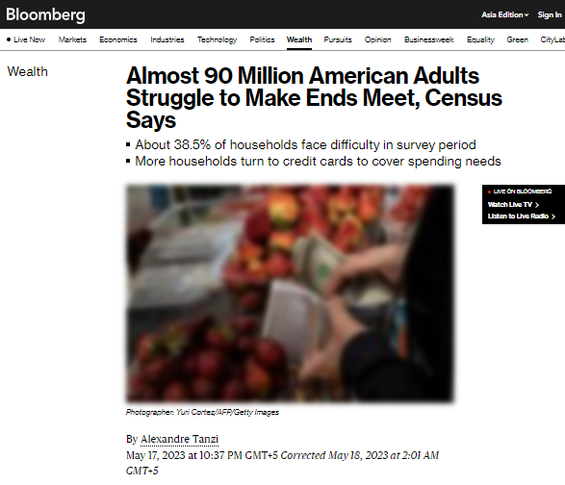
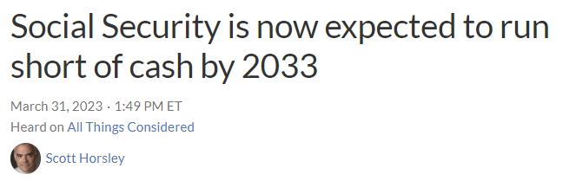
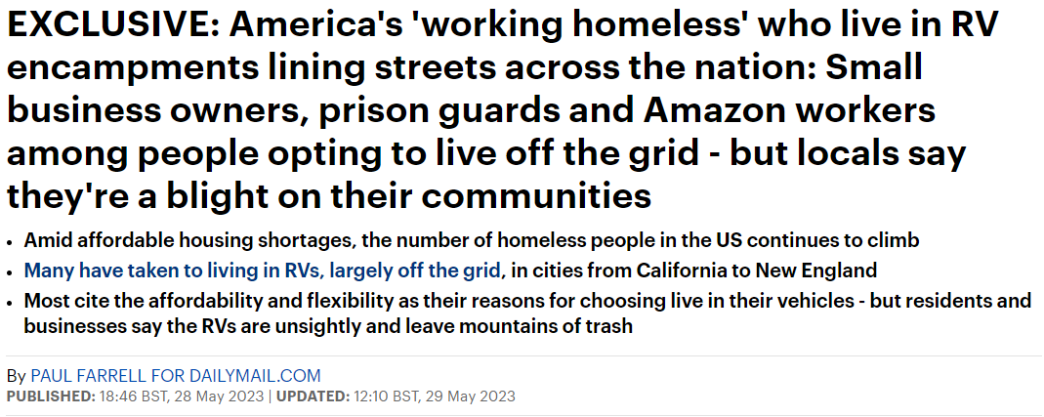
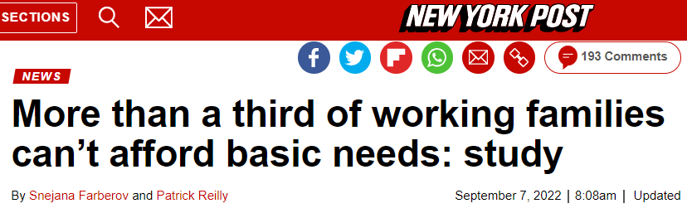
unhinging
4

Slide 9
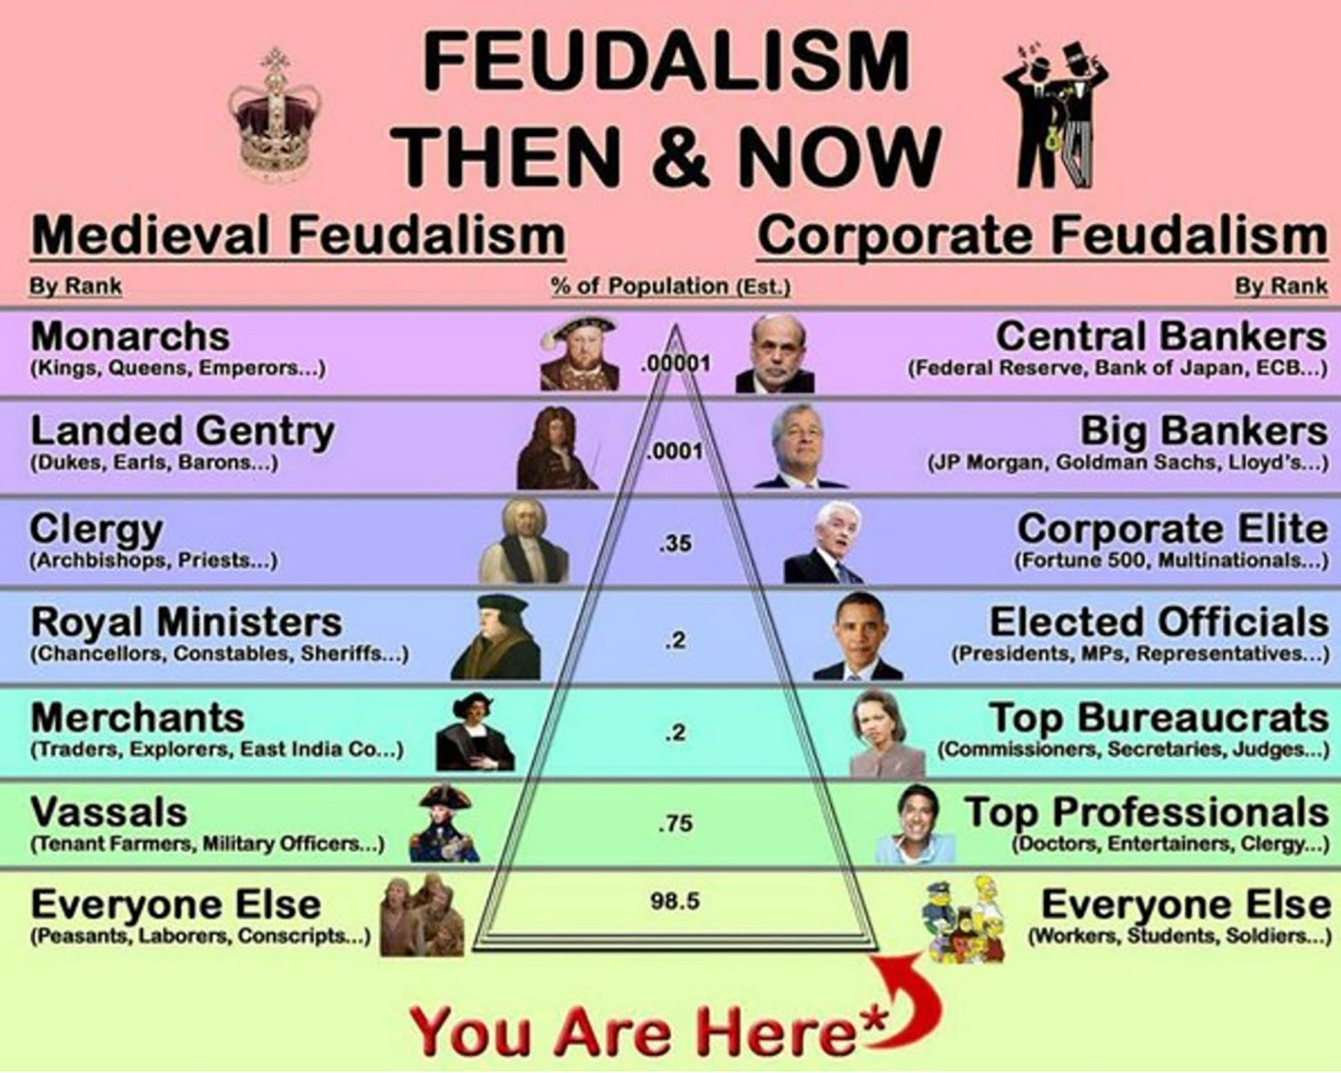
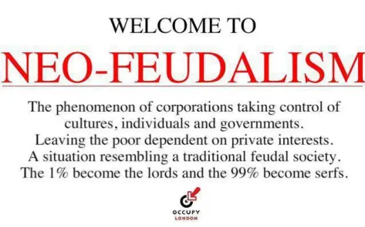
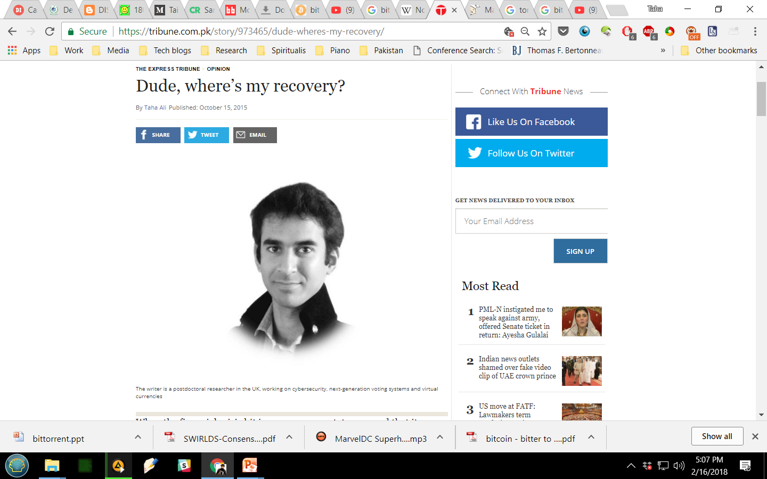
neofeudalism
4

Slide 10
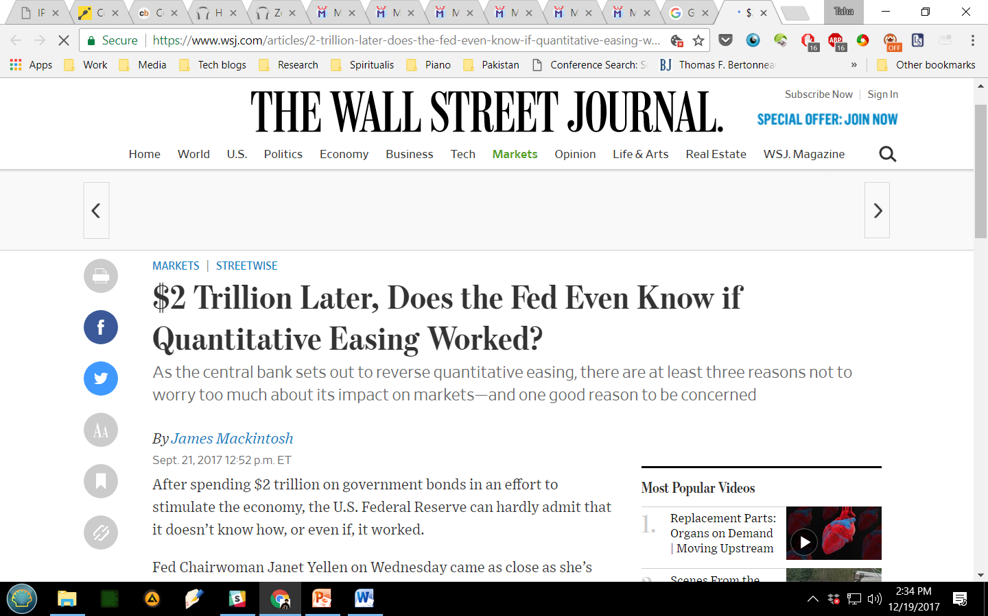
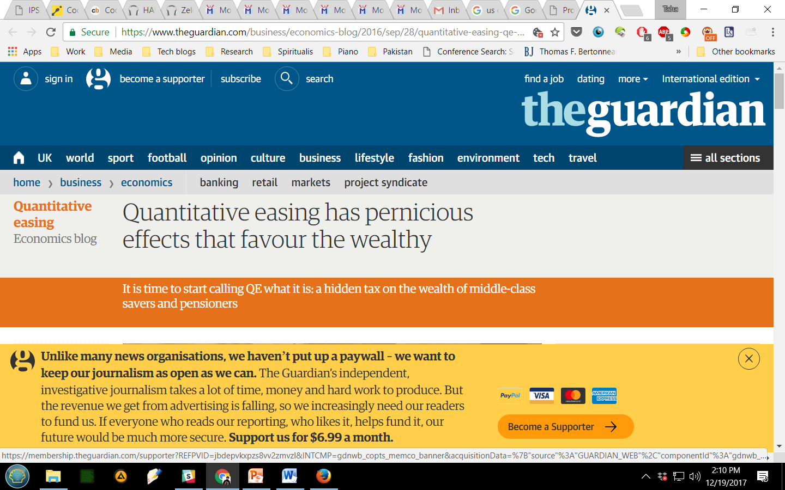
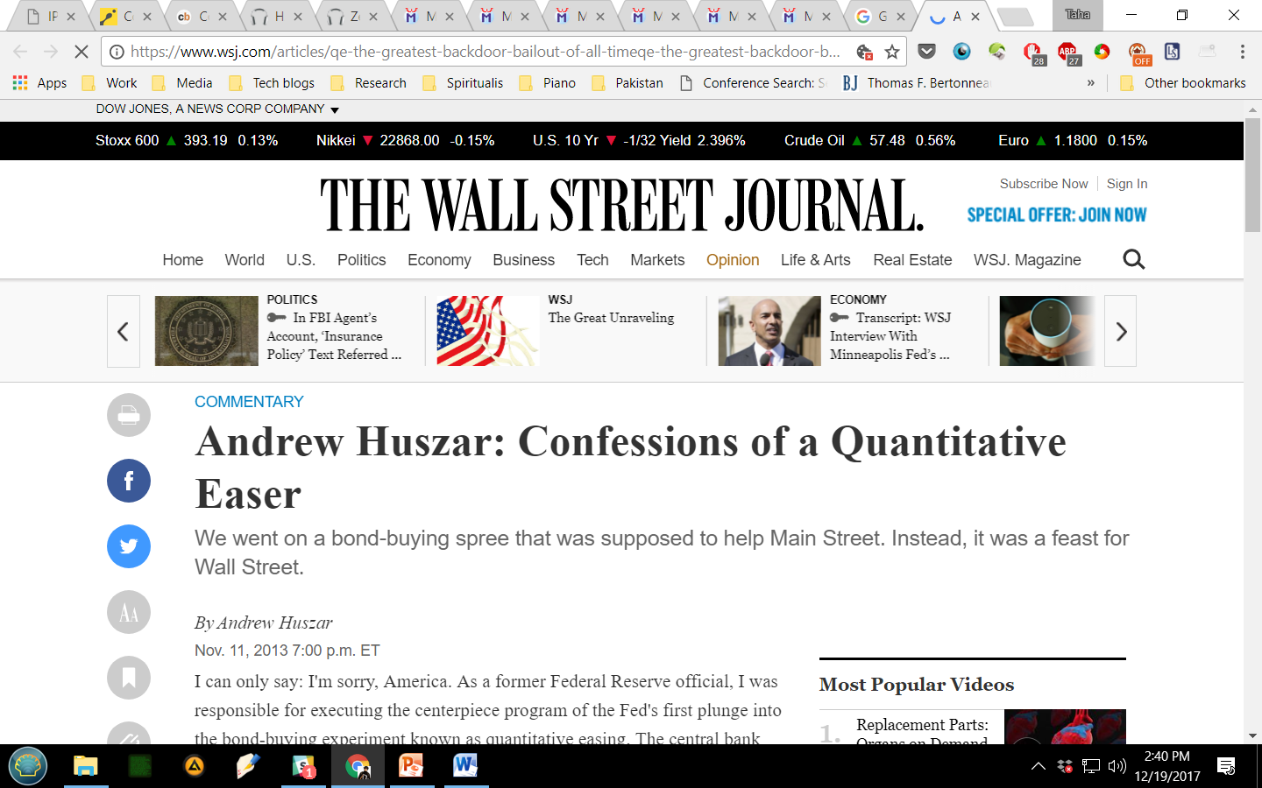
unhinging
4

Slide 11
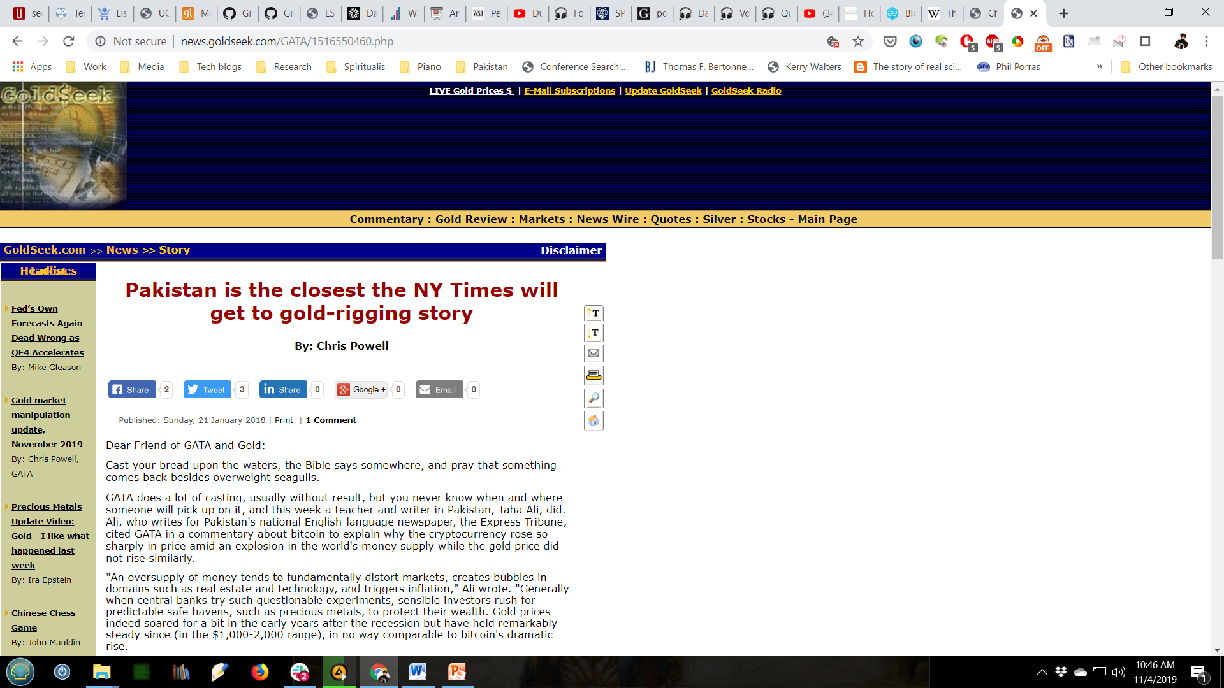
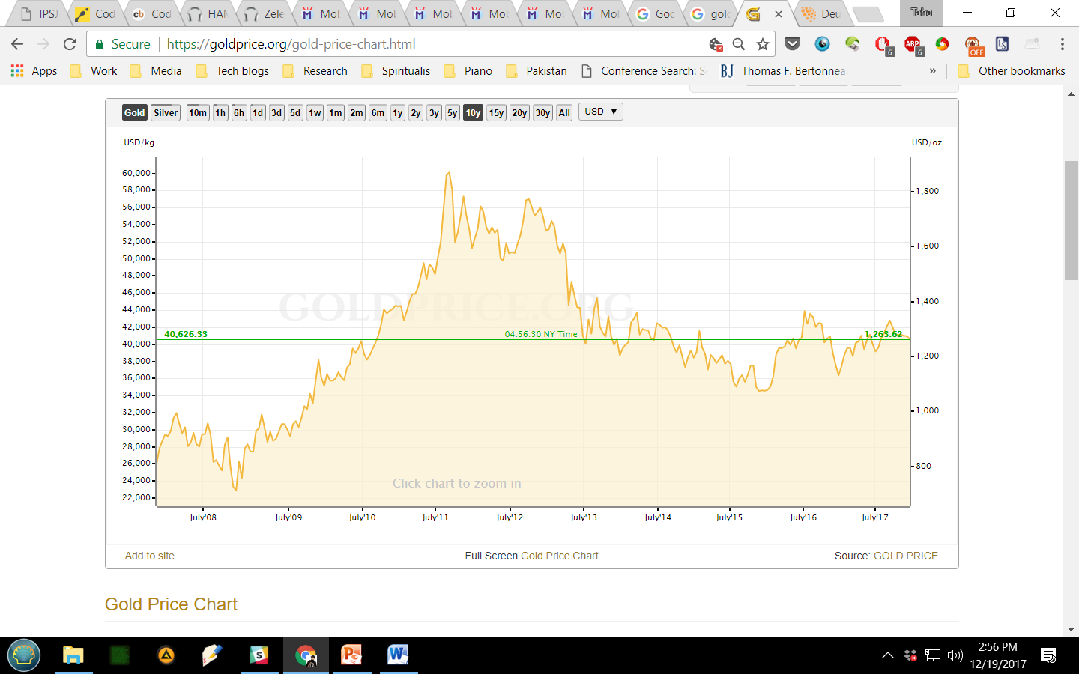
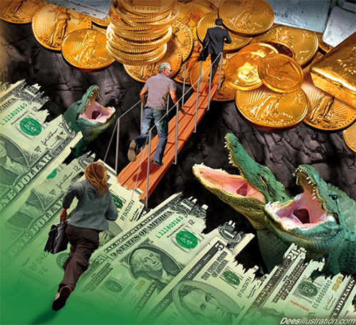
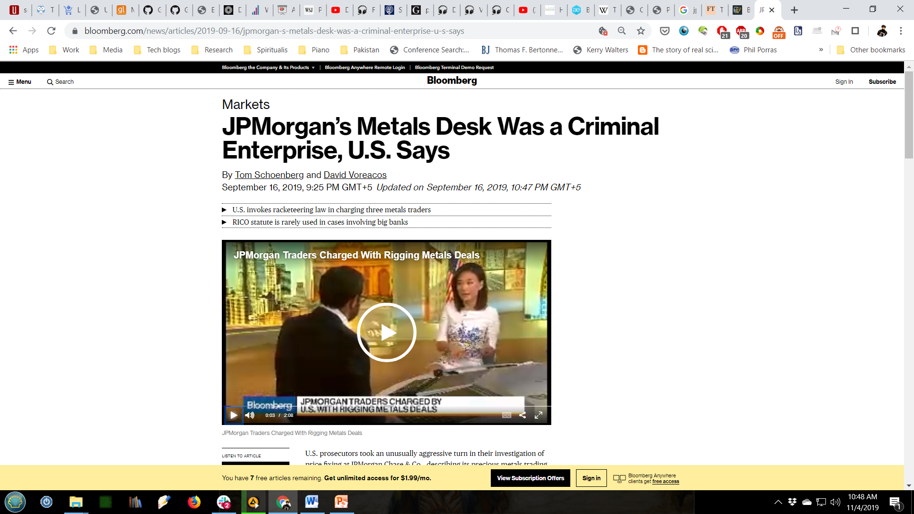
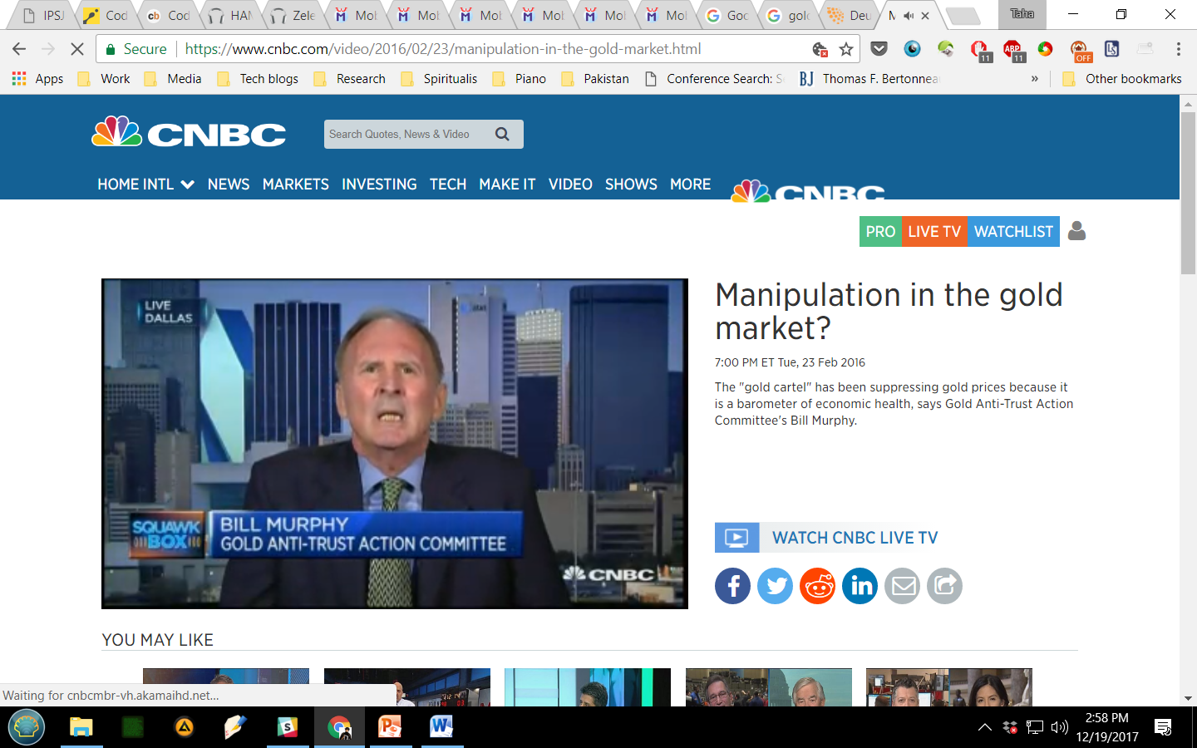
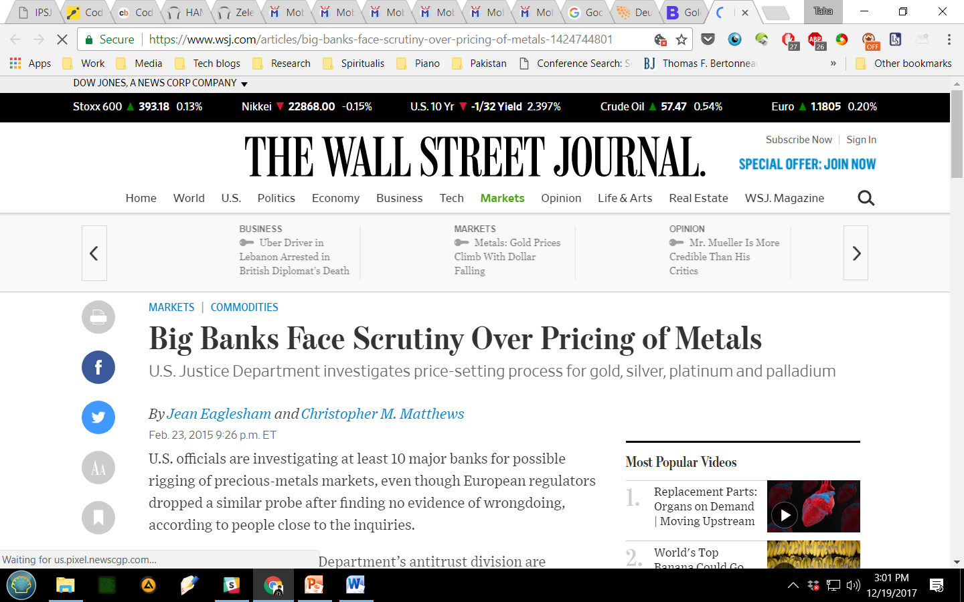
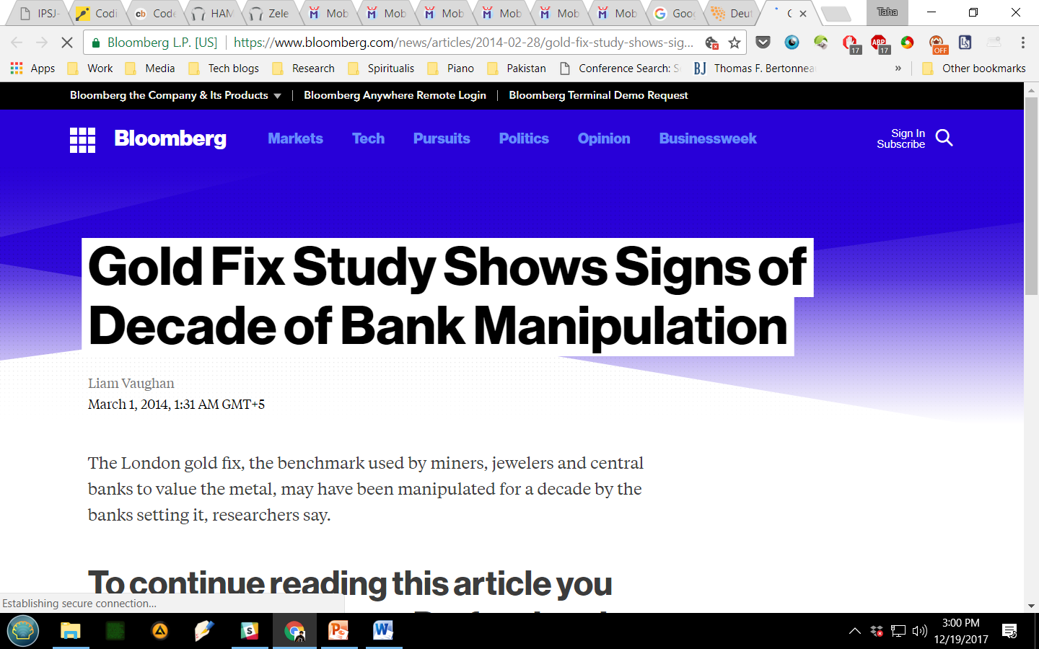
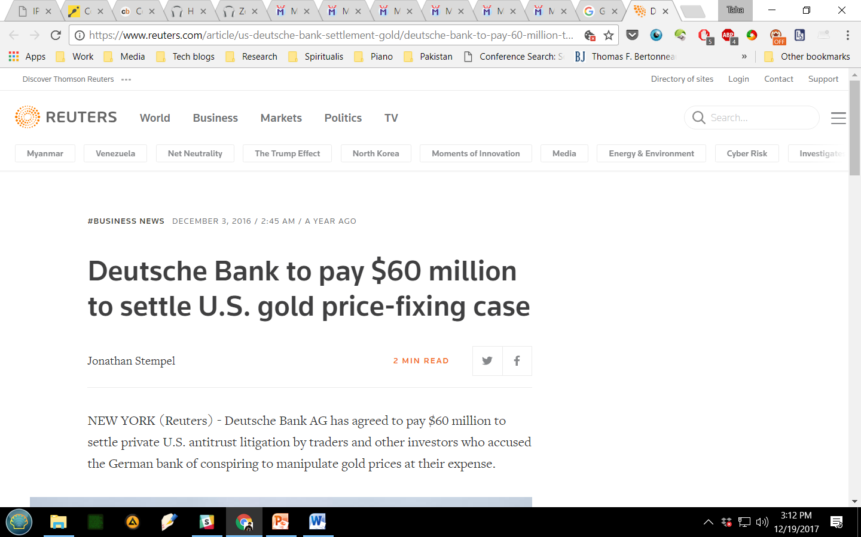
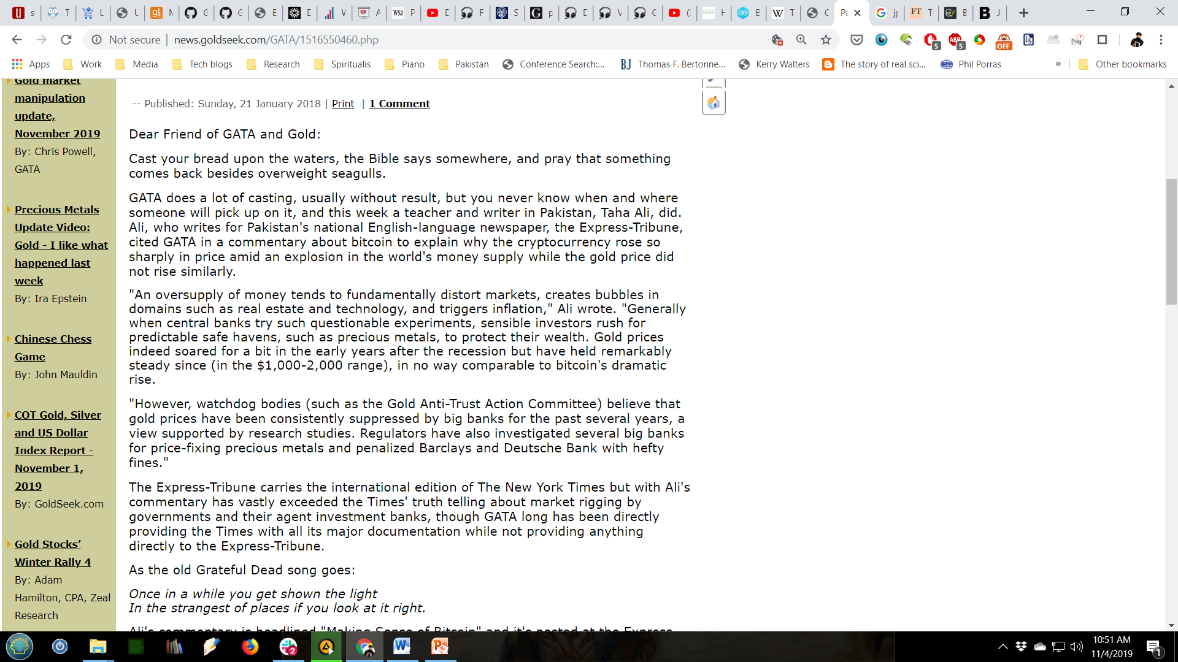
safe haven #1: gold
5

Slide 12
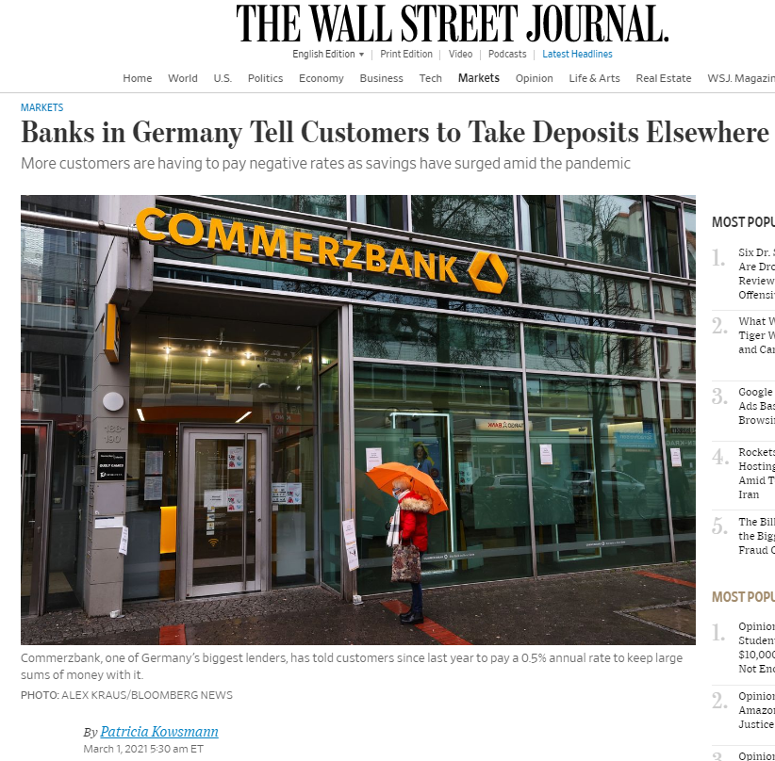
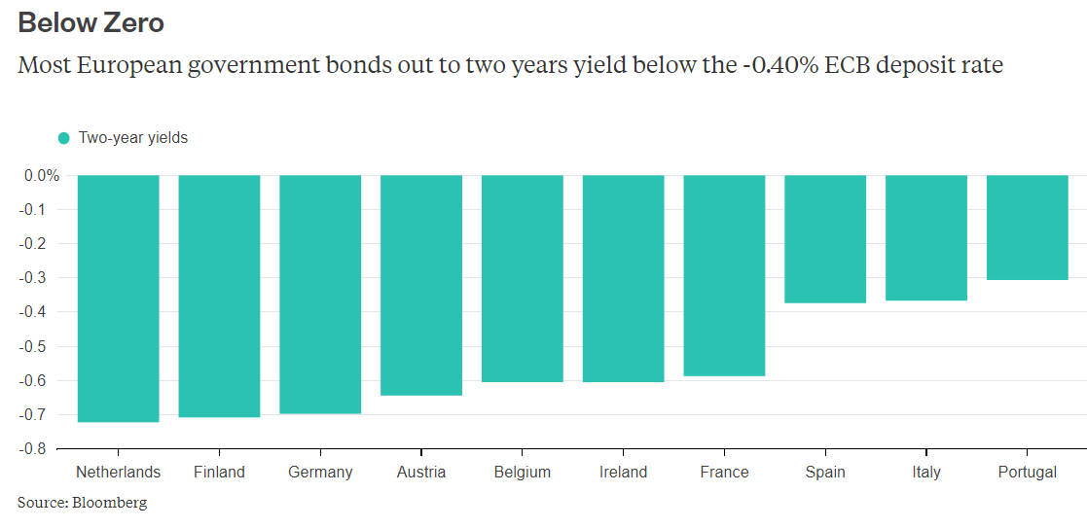
safe haven #2: bonds
6
bonds = interest (coupon) + principal (on maturity)
negative rates?

Slide 13
enter Bitcoin
7
everything is crazy…
“The root problem with conventional currency is all the trust that's required to make it work. The central bank must be trusted not to debase the currency, but the history of fiat currencies is full of breaches of that trust. Banks must be trusted to hold our money and transfer it electronically, but they lend it out in waves of credit bubbles with barely a fraction in reserve. We have to trust them with our privacy, trust them not to let identity thieves drain our accounts.”
– Satoshi Nakamoto

Slide 14
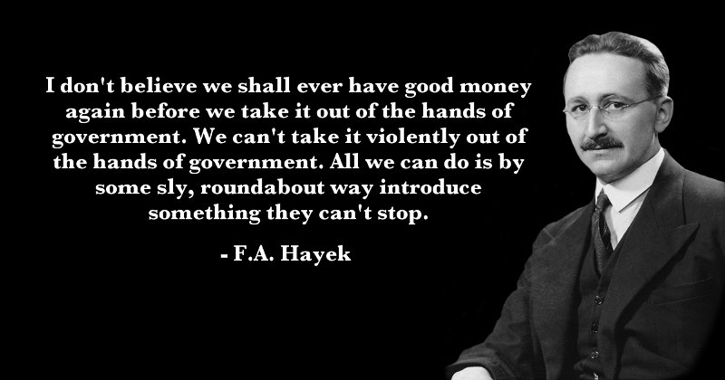
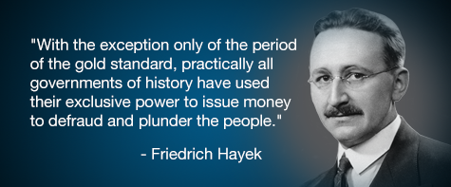
the Austrian school
7

Slide 15
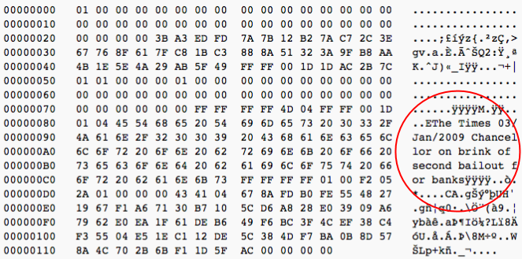
enter Bitcoin
8

Slide 16
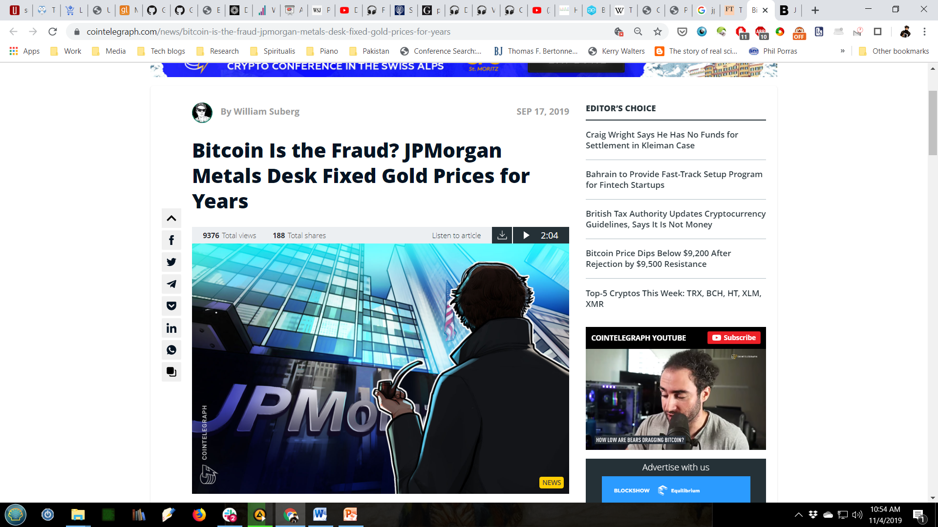
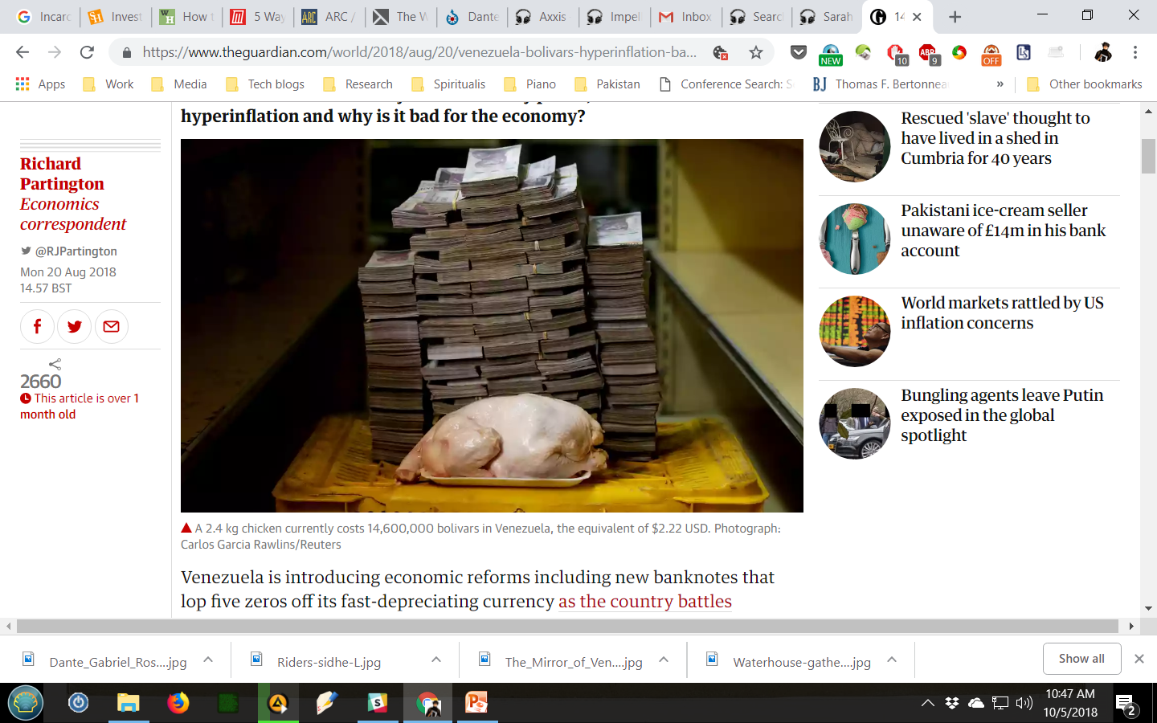
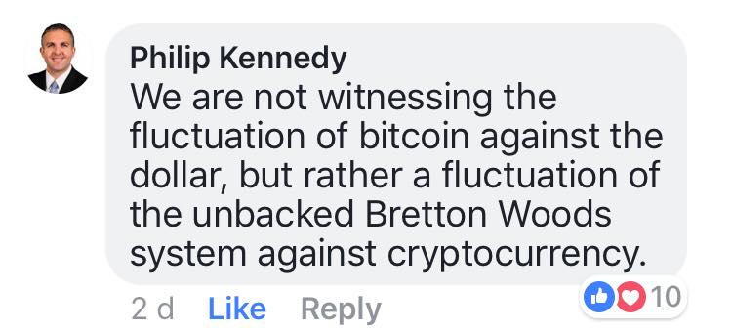
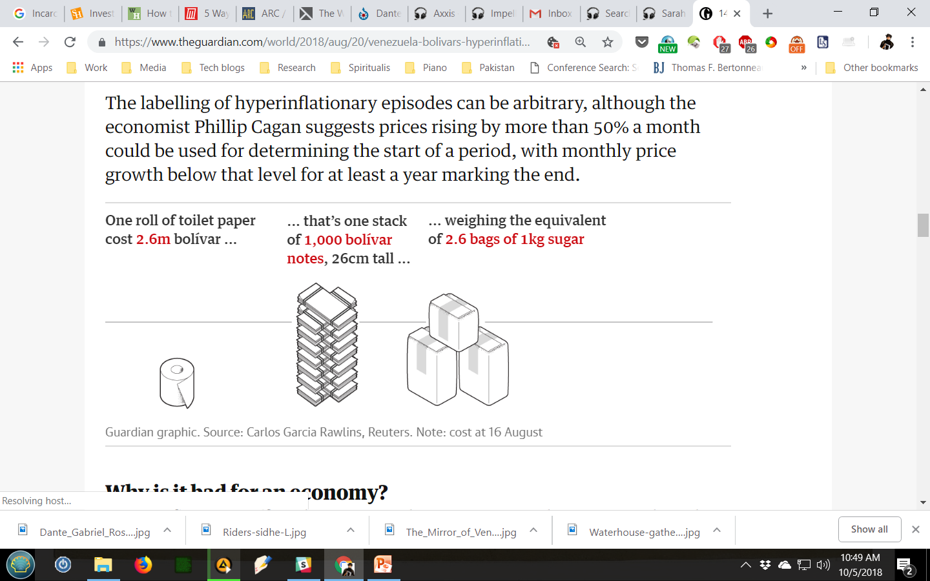
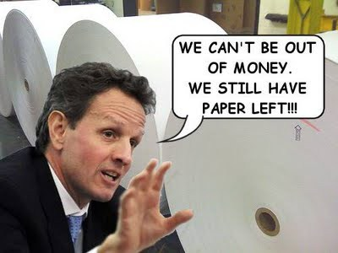
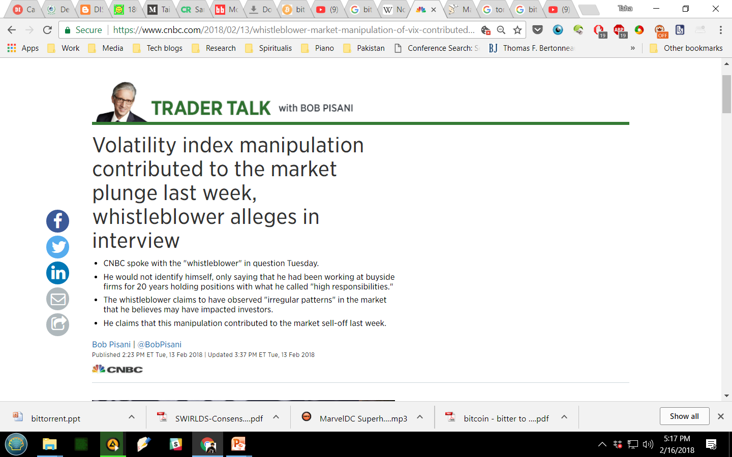


the struggle
9
the rationality of Bitcoin

Slide 17







the future?
10
anything can happen!
Notes:
According to Bitcoin analysis blog Digiconomist, energy consumed by Bitcoin mining now exceeds what is used by countries like Ireland, Hungary, Oman, and Lebanon. Bitcoin uses about as much power as the entire country of Morocco and slightly less than Bulgaria. If Bitcoin were a country, it would have the 61st highest energy consumption. However, this only covers miners. It does not include any power consumed by Bitcoin-enabled devices like vending machines and ATMs.

Slide 18

the future?
11
don’t be these folks!

